Slide 1
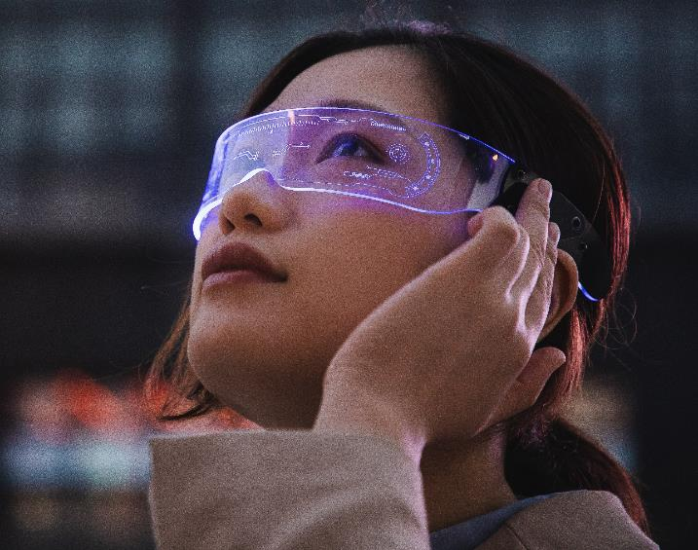
Face recognition using VIOLA & JONES algorithm and CSRT TRACKING (OPENCV) in hospitals
Project from AI Application course
Group C

Slide 2
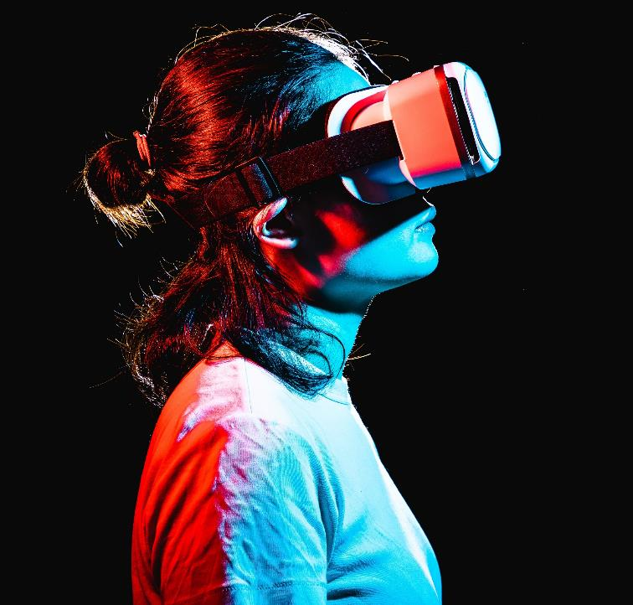
About us
Students from INHA UNIVERSITY in South Korea working in a small project from AI Application course leaded by Professor from ISE department Mehdi Pirahandeh based on deep learning and AI. Our project is based on face recognition on healthcare field in order to help both the citizens and assistants in hospital to save time and work efficiently. Let’s take a look at how face recognition impacts healthcare.

Slide 3

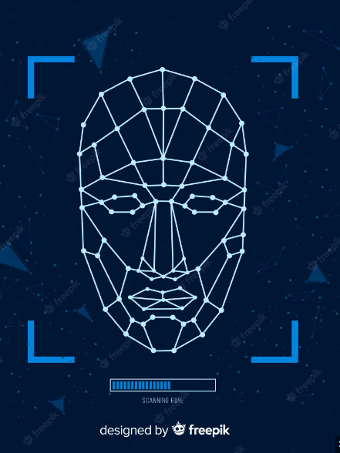
How does face recognition work?
Facial recognition is a technology that helps identify or verify a person based on their specific facial features. Detect human faces in images, videos or live feeds and compare them to a face database
In other words, all biometric models are mathematical representations of people's faces. In this way, biometric and personal information are strictly separated, ensuring the highest level of privacy, even when dealing with highly sensitive data.
The facial recognition software calculates the correspondence between the entered facial descriptor and all facial descriptors previously stored in a database. The goal is to find the face or faces from the database that most closely resemble the input face. The higher the match, the more likely the face is to be identified accurately.

Slide 4
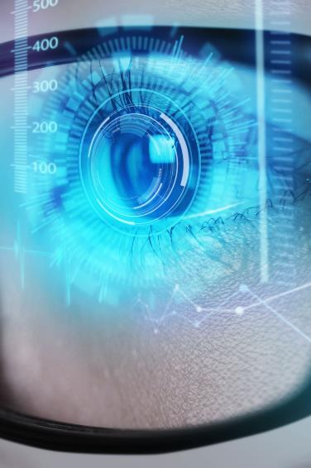



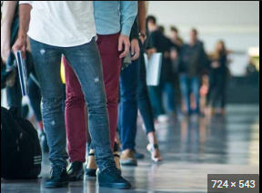
problem
Service IN HOSPITALS
In the waiting hall when patients take their waiting number, sometimes it takes too much time waiting for your turn, so therefore we should make an automated or checking mechanism that checks the people who left the hall.

Slide 5
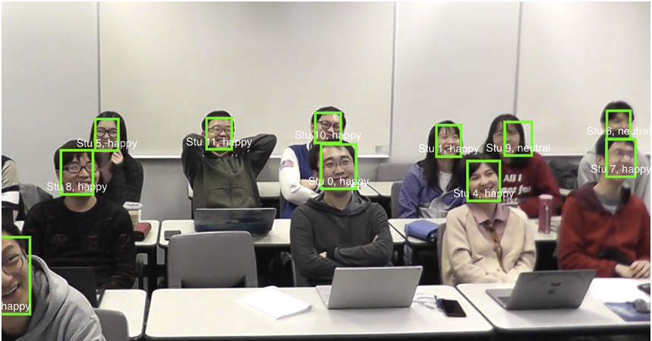
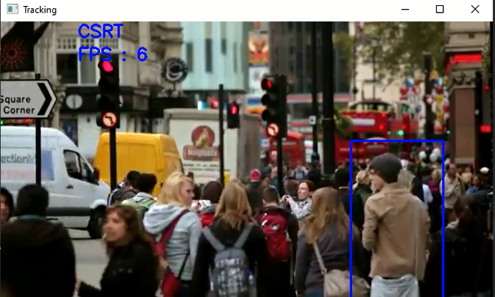
Solution
Our program makes managing tasks easier, and no other program on the market offers the same benefits. It checks the people faces when they are taking the waiting number and selects how mana people they are, so mechanism automatically cancels the number who left the hall or waiting room

Slide 6
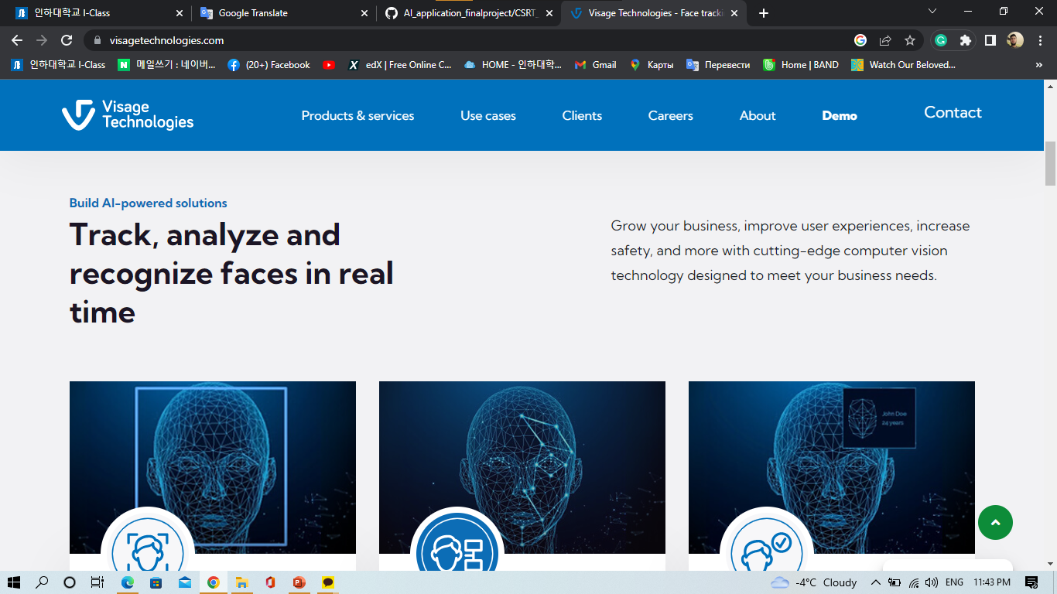

Previous researches
1. Visage technologies
https://visagetechnologies.com/face-recognition-in-healthcare/
They have already made a face recognition mechanism in healthcare including security
Facility security
Patient diagnosis and monitoring
Patient check in and check out
Access control
2.Genetic Based Face Recognition for Healthcare Applications
http://hdl.handle.net/10995/84113
They have already made a face recognition research in the field of security authentication
3-LEVEL DWT
GENETICALLY CLOSER
MOBILE TERMINAL

Slide 7




Project Overview
Unique
First to market
Testing
Authentic
Only program specifically dedicated to hospital management
First beautifully designed program that's both stylish and functional
Conducted testing with datasets we have and planning to test in a real atmosphere in future
Designed with the help and input of professors in this area

Slide 8


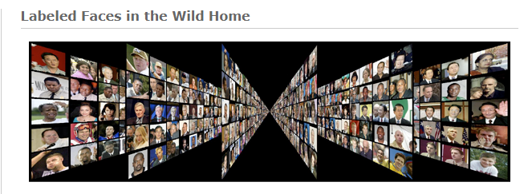
Face data collection(datasets)
1. Kaggle
We are going to use Kaggle for datasets that already exists.
https://www.kaggle.com/datasets/andrewmvd/face-mask-detection
2. VIS datasets
the link, on this one there is 13,000 thousand image, the one I download was name "all images as zipped tar file“
http://vis-www.cs.umass.edu/lfw/

Slide 9
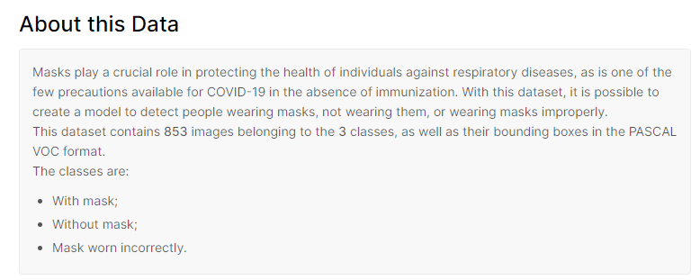
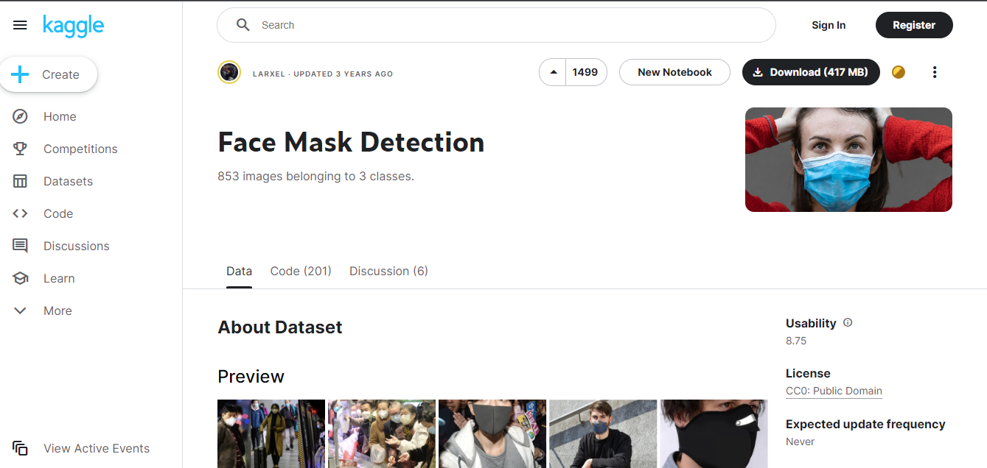

Viola & Jones algorithm using OpenCV
Ready images
Already annotated
in a cascade classifier format xml
Can be directly trained
https://www.kaggle.com/datasets/andrewmvd/face-mask-detection?select=annotations

Slide 10
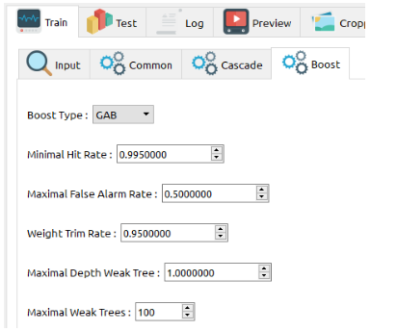
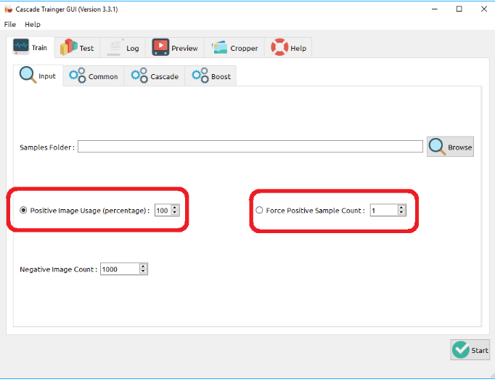
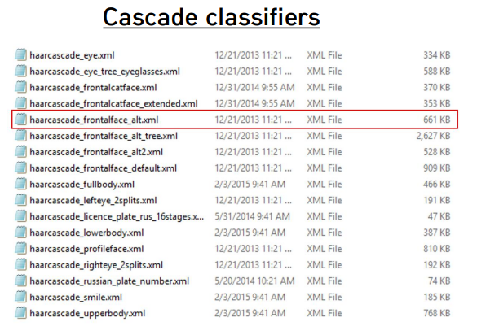
GUI cascade trainer for training our datasets with giving positive and negative images

Slide 11


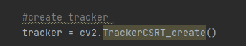
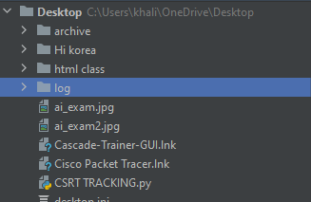
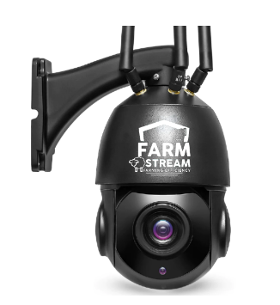
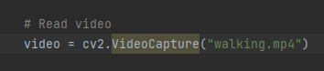
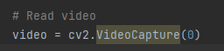
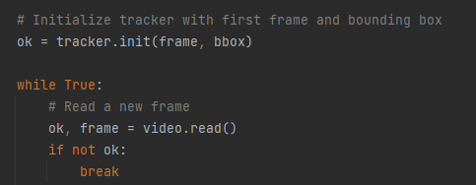
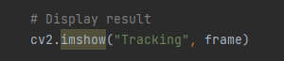
CSRT (Discriminative Correlation Filter with Channel and Spatial Reliability) tracker
We are using python code, with trained datasets
Using PyCharm to run and boot
we used a video to test it
We can also use live camera capture to track

Slide 12

The output example of csrt tracking using Opencv

Slide 13
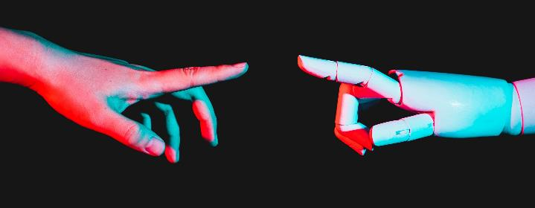
Implementation
In our scenario, we are planning to implement face recognition using OpenCV and Python.
Here are the necessary libraries that we will use in our project:
1.Opencv
2.Dlib
3.Face_recognition

Slide 14
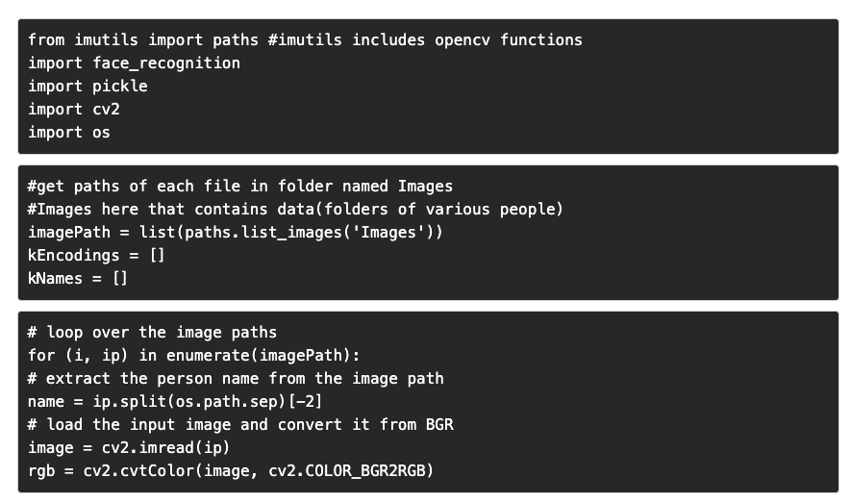
Extract facial features
First, it is necessary to have a dataset. The dataset should contain all images in folders with each folder containing images of the people.
The python code for face recognition

Slide 15
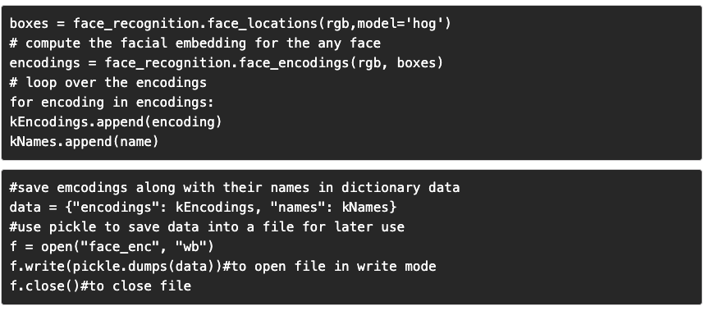
The python code for face recognition(cont.)

Slide 16
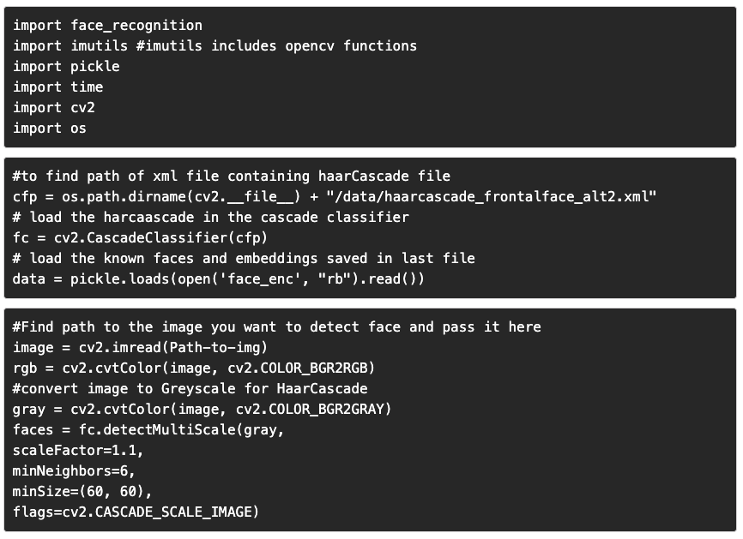
How to recognize face in images

Slide 17
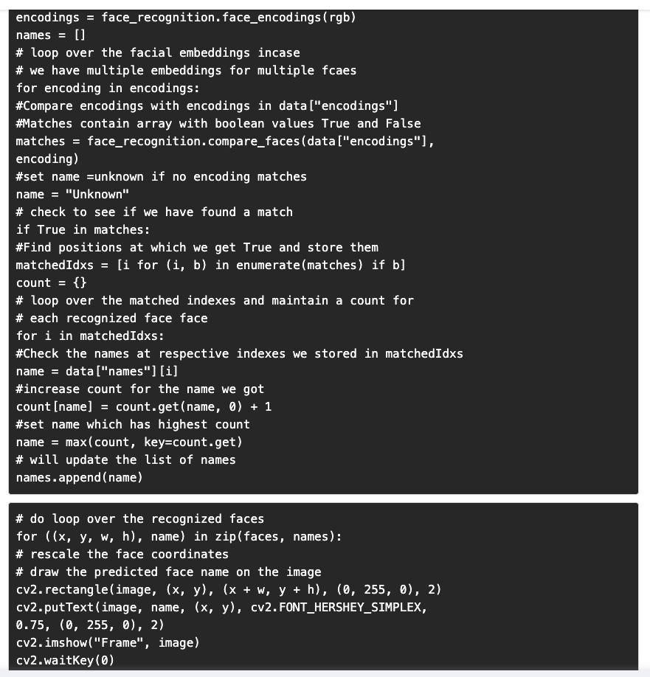
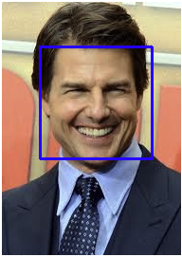
How to recognize face in images(cont.)
output

Slide 18


Github link
https://github.com/Khai2708/AI_application_finalproject.git
All source files are uploaded to Github
Source file
https://github.com/Khai2708/AI_application_finalproject/blob/main/CSRT_FACE_TRACKING.py
11/13/2022
INHA university. © all rights reserved
18

Slide 19

Summary
The implementation of facial recognition technology in healthcare has transformed many surgeries for the better. From improved patient safety and identification to better patient tracking and diagnosis, this has helped improve the patient experience and reduce the workload of healthcare workers.
Facial recognition will be even more ubiquitous in the future than it is today. Advanced health monitoring and care robots are just some of the applications being developed. The potential for facial recognition in healthcare is huge, and we haven't seen the best of it yet.

Slide 20
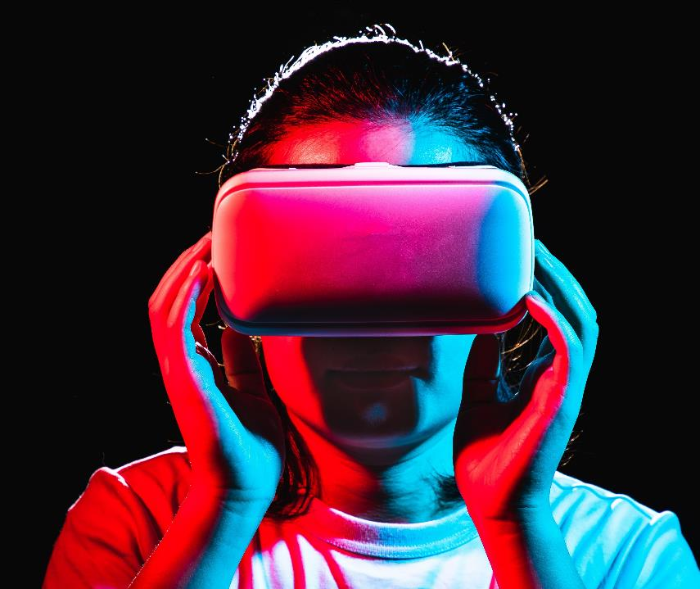
Thank you
AI APPLICATION COURSE
Group C
ASADBEK 12194882
ULUGBEK 12194914
ABDULLOKH 12194900
KOBILJON 12194939
KALANDAROV BEKZODBEK

